Slide 1


Valentina Chimitova
07.18.2024

Slide 2

Outline
Executive Summary
Introduction
Methodology
Results
Conclusion
Appendix

Slide 3
Executive Summary
The research process followed the Data Science methodology involving data collection, data wrangling, exploratory data analysis, data visualization, model development, and model evaluation.
Key Findings:
The analysis showed that launches from KSC LC-39A have the highest success rate for first-stage landings.
The success rate of first-stage landings has generally increased over time, with significant improvements observed after 2015.
Analysis:
Data from over 100 launches were analyzed using various machine learning models, including Decision Tree, K-Nearest Neighbors, Support Vector Machine, and Logistic Regression.
The Decision Tree model provided the highest cross-validation accuracy at 87.68%.
Conclusions:
Launch site proximity to the equator and specific orbital requirements significantly influence the success rate of first-stage landings.
The Decision Tree model was determined to be the most effective for predicting launch outcomes due to its high interpretability and accuracy.

Slide 4
Introduction
The final project aims to predict the successful landing of the Falcon 9 first stage. SpaceX offers Falcon 9 rocket launches for $62 million, significantly lower than the over $165 million charged by other suppliers. The primary savings come from SpaceX's ability to reuse the first stage. By predicting the likelihood of a successful first stage landing, we can better estimate the launch cost. This information can be used to competitively bid against SpaceX for rocket launches.
Main goals:
Describe the activities of SpaceX and the geographical location of the launch sites.
Conduct statistical analysis of the success rates of first stage landings.
Create prediction models for successful landings.
Key questions to address:
What main characteristics should our product have?
Can our startup compete with SpaceX, and under what conditions?

Slide 5

Section 1

Slide 6
Methodology
Executive Summary
Data collection methodology:
Utilized the SpaceX API and web scraping techniques to gather data
Perform data wrangling
Employed Python libraries such as Pandas and Numpy for data cleaning and transformation
Perform exploratory data analysis (EDA) using visualization and SQL
Perform interactive visual analytics using Folium and Plotly Dash
Perform predictive analysis using classification models
Developed and evaluated models using key machine learning algorithms from the Sklearn library

Slide 7
Data Collection
Data Sources:
SpaceX API (https://api.spacexdata.com/v5/launches/past)
Wikipedia (https://en.wikipedia.org/w/index.php?title=List_of_Falcon_9_and_Falcon_Heavy_launches&oldid=1027686922)
Tools and Libraries:
Requests: For API calls and HTTP requests.
BeautifulSoup: For parsing HTML and extracting data.
Unicodedata: For text normalization.
Pandas & Numpy: For data manipulation and numerical operations.
Web Scrapping from Wikipedia
Request data from the SpaceX API ↓ Decode and transform the response ↓ Clean the data ↓
Data analysis
↓
Data wrangling
↓
Export the data to CSV
SpaceX API data collection
Extract HTML table from Wikipedia
↓
Parse the table and convert it into a Pandas DataFrame
↓
Clean the data
↓
Export the data to CSV

Slide 8
Data Collection – SpaceX API
Import Required Libraries
Define Helper Functions for JSON Data Extraction
Request Data from SpaceX API (send HTTP GET requests)
Convert to Pandas DataFrame
Filter and Handle Missing Data
Export to CSV (dataset_part_1.csv)
Decode and Normalize Data
(Pandas json_normalize)
SpaceX API: Gathered detailed information on Falcon 9 launches, including launch dates, payload mass, landing outcomes, and other relevant metrics.
https://github.com/vchim111/Data-Science-Capstone-Project/blob/main/M1-Lab1-spacex-data-collection-api.ipynb

Slide 9
Data Collection – Scraping
Import Required Libraries
Define Helper Functions for HTML Table Extraction
Request Data from Wikipedia (send HTTP GET requests)
Convert to Pandas DataFrame
Filter and Handle Missing Data
Export to CSV (Spacex_web_scrapped.csv)
Decode and Normalize Data
(BeautifulSoup object)
Wikipedia: Extracted Falcon 9 and Falcon Heavy Launches Records, including version booster, customer, payload, booster landing, and other related data.
https://github.com/vchim111/Data-Science-Capstone-Project/blob/main/M1-webscraping.ipynb

Slide 10
Data Wrangling
Performed data wrangling and analysis to identify patterns within the data and determine the appropriate labels for training supervised models.
https://github.com/vchim111/Data-Science-Capstone-Project/blob/main/M1-Lab2-Data%20wrangling.ipynb
Import Libraries and Define Auxiliary Functions
Load dataset (dataset_part_1.csv) and save as Pandas DataFrame
Handle Missing Data, Calculation of key statistical indicators
Creating a Target Variable ‘Class’ for Landing Outcome
Export to CSV (dataset_part_2.csv)

Slide 11
EDA with Data Visualization
In the process of studying how the variables FlightNumber (indicating continuous launch attempts) and Payload affect the launch result, the following graphs were built:
The Flight Number vs Payload Mass,
The Flight Number vs Launch Site,
Scatter Plot of Launch Site vs Payload Mass,
Success Rate by Orbit,
Scatter Plot of Orbit vs Flight Number,
Scatter Plot of Orbit vs Payload Mass, Launch success yearly trend
https://github.com/vchim111/Data-Science-Capstone-Project/blob/main/M2-eda-dataviz.ipynb

Slide 12
EDA with SQL
Main SpaceX Launch Sites: Florida (CCAFS LC-40 and SLC-40, KSC LC-39A); California (VAFB SLC-4E)
Payload Mass for SpaceX launches: Total = 619,967 kg; Average = 6,138.29 kg
First Successful Ground Landing: 2015-12-22
Successful Drone Ship Landings (Payload 4000 - 6000 kg): F9 FT B1022; F9 FT B1026; F9 FT B1021.2; F9 FT B1031.2
Mission Outcomes: 100 Successful and 1 Failure
Maximum Payload Booster Version: 12 booster versions
2015 Drone Ship Failures: In January and April, booster version v1.1, from CCAFS LC-40.
Rank Landing Outcomes Between 2010-06-04 and 2017-03-20
https://github.com/vchim111/Data-Science-Capstone-Project/blob/main/M2-eda-sql-coursera_sqllite.ipynb

Slide 13
Build an Interactive Map with Folium
Locations of Sites findings:
- Sites like Cape Canaveral (CCAFS and KSC) benefit from the Earth's higher rotational speed near the equator, making eastward launches more efficient.
- Proximity to railways, highways, and coastline is essential for the launch complex functionality.
Launch Site Proximity:
- General Proximity: Approximately 1 kilometer or less to key infrastructure.
- Exception: KSC LC-39A is 6.5 kilometers from the coastline.
- Nearest City: At least 13 kilometers away from each launch site.
Landing Outcomes Map Markers (help visualize the success of the launch site):
- Green: Successful first stage landings.
- Red: Failed first stage landings.
https://github.com/vchim111/Data-Science-Capstone-Project/blob/main/M3-launch_site_location.ipynb

Slide 14
Build a Dashboard with Plotly Dash
Pie Chart Summary:
Successful Landings: Highest at KSC LC-39A (41.7%); Lowest at CCAFS SLC-40 (12.5%).
Success Rate Example: KSC LC-39A shows a 76.9% success rate for first stage landings.
Scatter Plot Insights:
Payload Range: Focuses on payloads between 4000 and 6000 kg.
Engine Performance: FT, B4, and B5 engines demonstrate the best performance.
Payload Impact: Launches with payloads over 5.5 tons have a lower success rate for first stage landings.
KSC LC-39A stands out with the highest percentage of successful landings and overall success rate. The performance of engines and payload considerations play a critical role in the success of first stage landings.
https://github.com/vchim111/Data-Science-Capstone-Project/blob/main/M3-spacex_dash_app.py

Slide 15
Predictive Analysis (Classification)
Model Selection:
All machine learning models performed equally well on the test data, with accuracies exceeding 83.33%. The Decision Tree model is preferred for its high interpretability, effectiveness in handling outliers, and achieving the highest cross-validation accuracy among the considered models.
Confusion Matrix Details: True Positives (TP = 12); True Negatives (TN = 3);
False Negatives (FN = 0); False Positives (FP = 3).
Summary:
- The model demonstrates excellent recall and good precision, accurately identifying positive instances while having a moderate rate of false positives.
The overall accuracy is 83.3%, indicating reliable performance in most cases.
https://github.com/vchim111/Data-Science-Capstone-Project/blob/main/M4-SpaceX_Machine_Learning_Prediction_Part_5.jupyterlite.ipynb

Slide 16
Results
Exploratory Data Analysis
- Identified key SpaceX launch sites and their characteristics.
- Calculated total and average payload mass for SpaceX launches.
- Determined the date of the first successful ground landing.
- Analyzed successful and unsuccessful mission outcomes and payload specifics.
Interactive Analytics Demo
- Demonstrated data insights through screenshots of interactive visualizations.
- Highlighted key features and findings from the dataset.
Predictive Analysis
- Evaluated multiple machine learning models, with Decision Tree showing the best performance.
- Decision Tree model selected for its high interpretability and highest cross-validation accuracy.
- Presented confusion matrix and key performance metrics, showing good overall model performance.
Overall, the analysis provided comprehensive insights into SpaceX launches and identified the most effective machine learning model for predicting outcomes.

Slide 17

Section 2

Slide 18
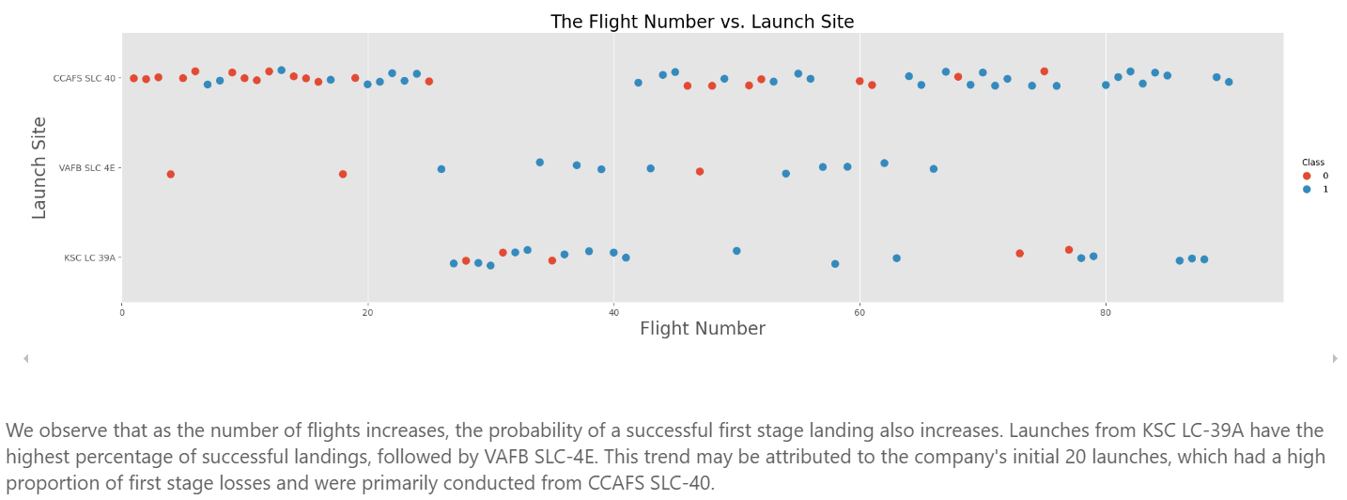
Flight Number vs. Launch Site

Slide 19
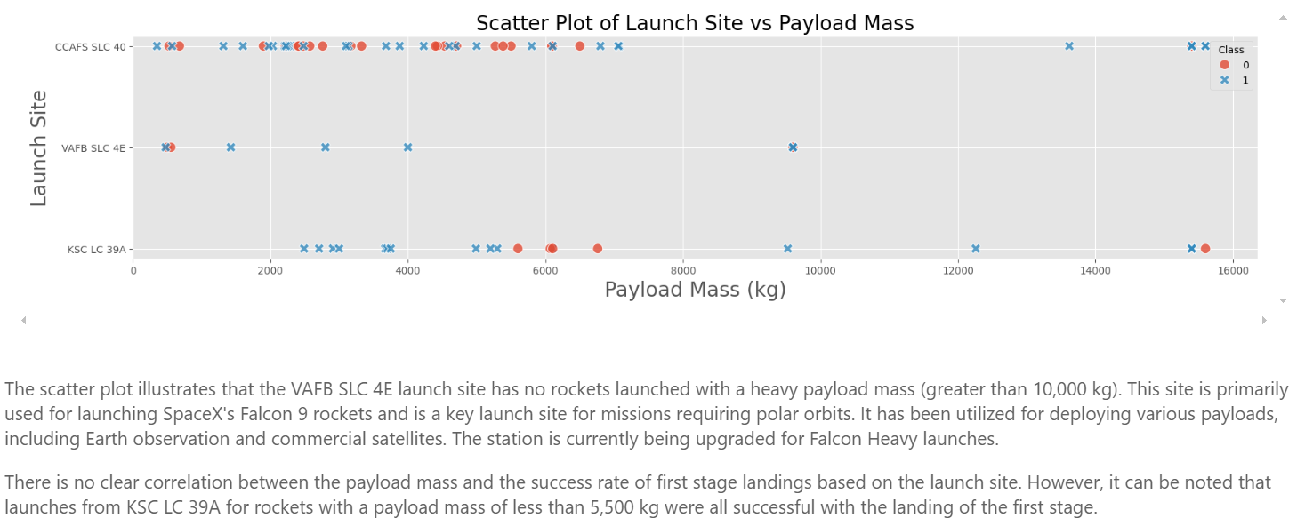
Payload vs. Launch Site

Slide 20
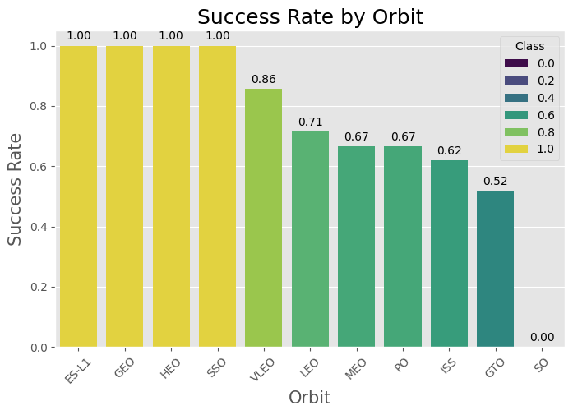
Success Rate vs. Orbit Type
The success rates for different orbits:
ES-L1, GEO, HEO, and SSO: 1,1,1, and 5 launches with 100% success rate.
SO: 0% success rate, with 1 flight not achieving a successful first stage landing.
GTO: 27 launches, 52% success rate.
ISS: 21 launches, 62% success rate.
VLEO: 14 launches, 86% success rate.
PO: 9 launches, 67% success rate.
MEO: 3 launches, 67% success rate.
LEO: 14 launches, 71% success rate.

Slide 21
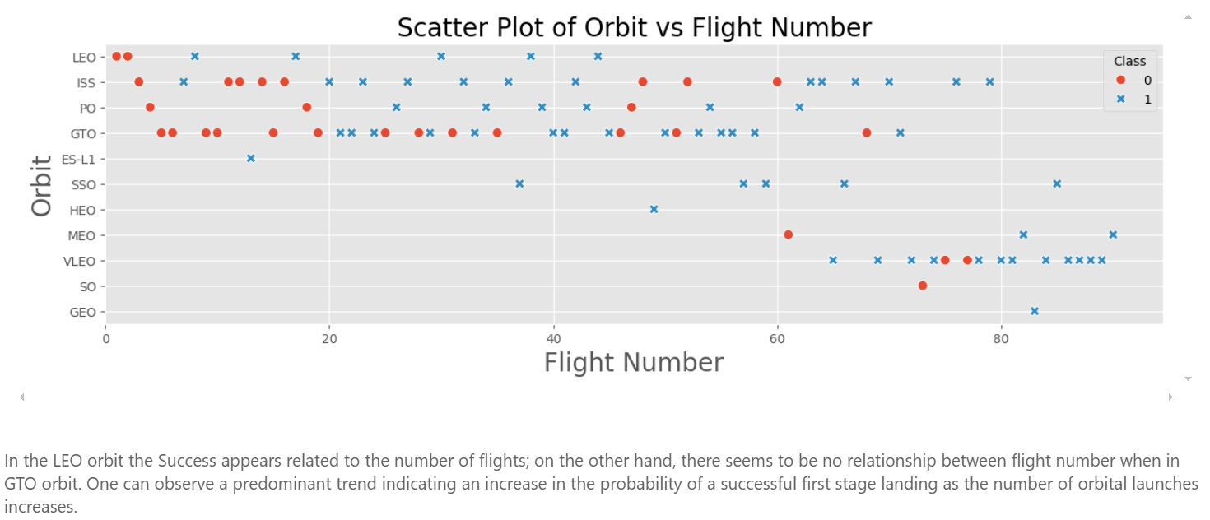
Flight Number vs. Orbit Type

Slide 22
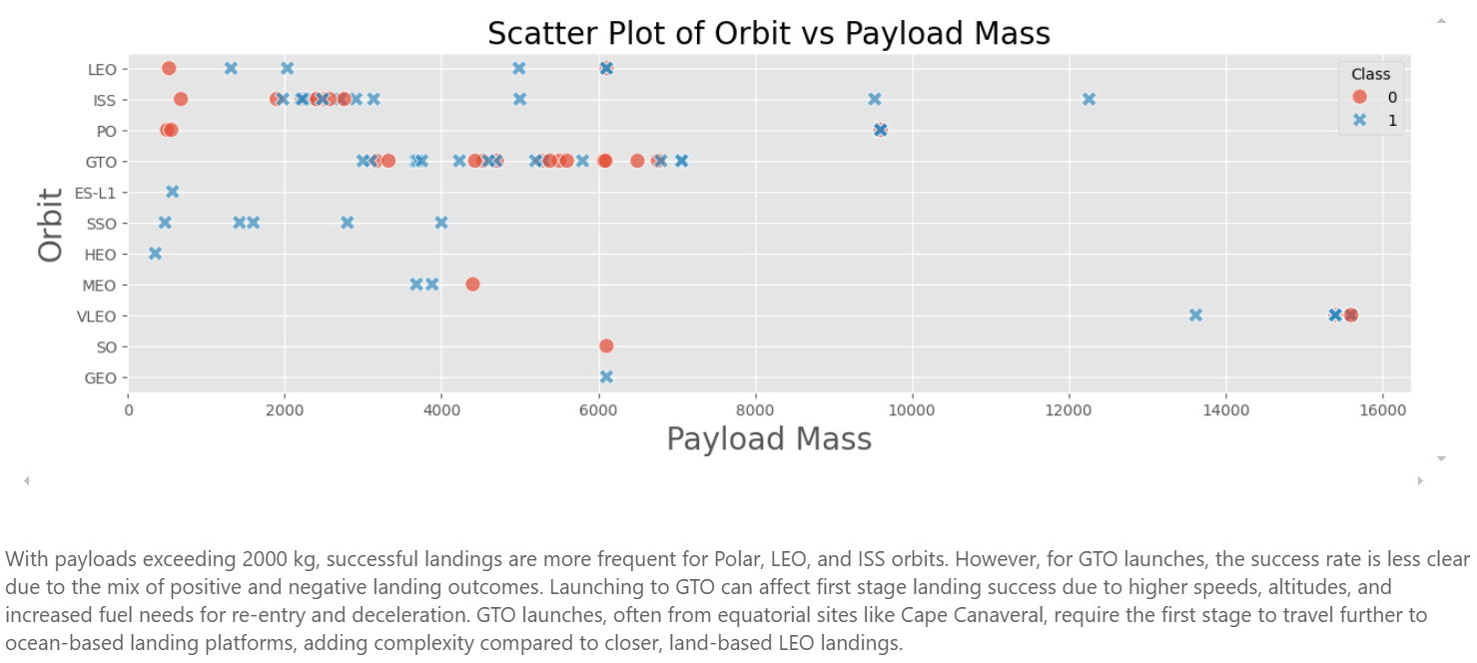
Payload vs. Orbit Type

Slide 23
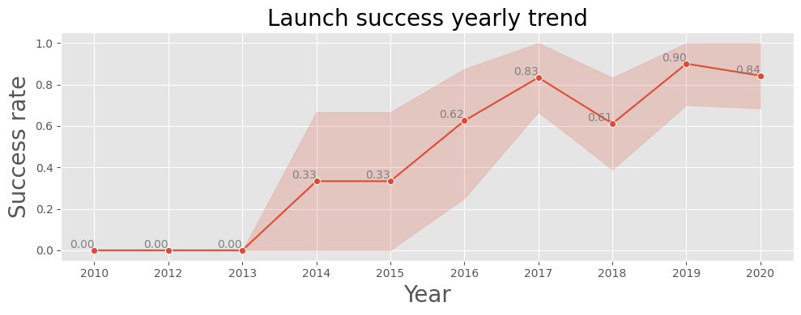
Launch Success Yearly Trend
We can observe that the success rate has been increasing since 2013, remaining stable in 2014. After 2015, it continued to rise, except for a dip in 2018.

Slide 24
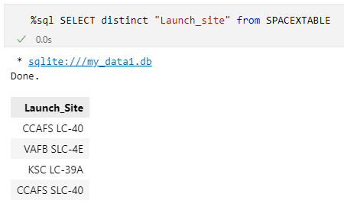
All Launch Site Names
The screenshot displays the result of the SQL query for the unique launch sites from the my_data1.db database. The data is requested from the SPACEXTABLE table.
Main SpaceX Launch Sites (for Falcon 9 launches):
Cape Canaveral Space Force Station (CCAFS) and Kennedy Space Center (KSC), Florida
CCAFS LC-40 and SLC-40: Used for launching commercial, government, and military satellites.
KSC LC-39A: A site leased from NASA, used for crewed missions to the ISS and other missions.
Vandenberg Space Force Base (VAFB), California
SLC-4E: Used for launches to polar orbits and sun-synchronous orbits. Launching to such orbits requires flights to the south or north, which is possible from this base.

Slide 25
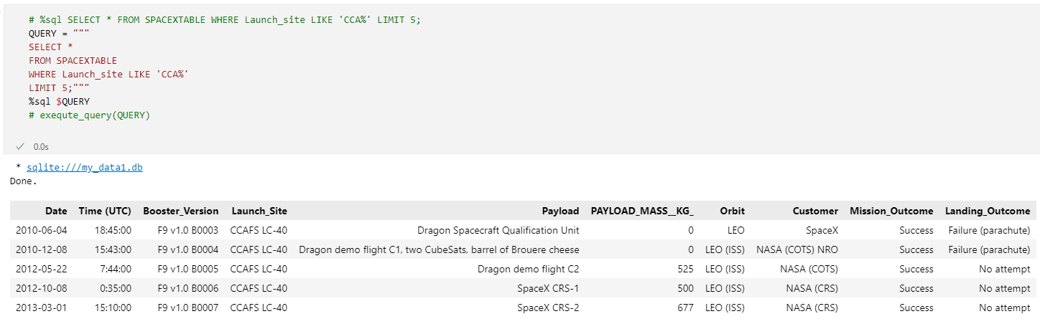
Launch Site Names Begin with 'CCA'
The SQL query retrieves all columns from the SPACEXTABLE for records where the Launch_site starts with 'CCA'. It limits the output to the first 5 records. The query is executed using the %sql magic command.

Slide 26
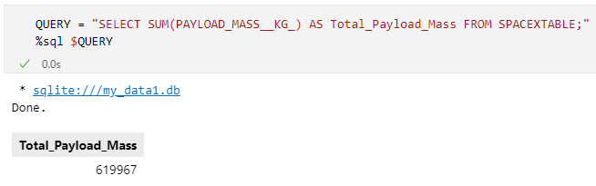
Total Payload Mass
The SQL query calculates the total payload mass from the SPACEXTABLE by summing the PAYLOAD_MASS__KG_ column. The result above presents the total payload carried by boosters from NASA.

Slide 27
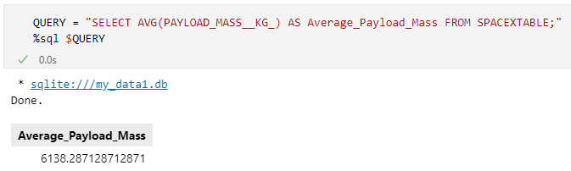
Average Payload Mass by F9 v1.1
The query calculates the average payload mass carried by SpaceX launches. The result provides a single value representing the mean payload mass across all entries in the `SPACEXTABLE`.

Slide 28
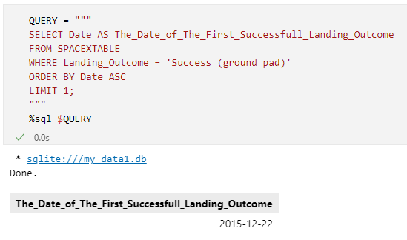
First Successful Ground Landing Date
The query identifies the date of the first successful landing of a SpaceX rocket on a ground pad. By filtering for successful landings and ordering the results by date, it finds the earliest successful ground landing date.

Slide 29
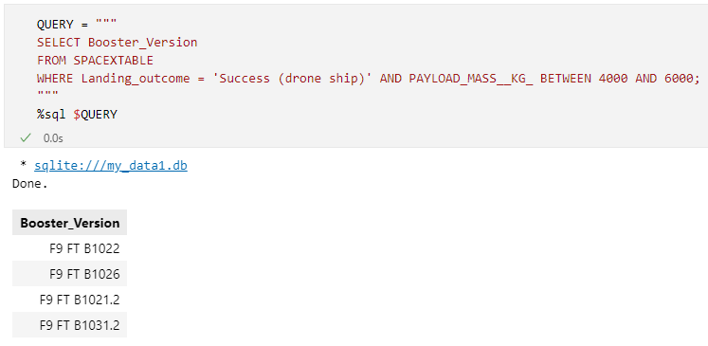
Successful Drone Ship Landing with Payload between 4000 and 6000
This query retrieves the booster versions from the SPACEXTABLE where the landing outcome was successful on a drone ship and the payload mass was between 4000 kg and 6000 kg. It helps identify which booster versions were successfully recovered on drone ships for payloads within this specified range

Slide 30
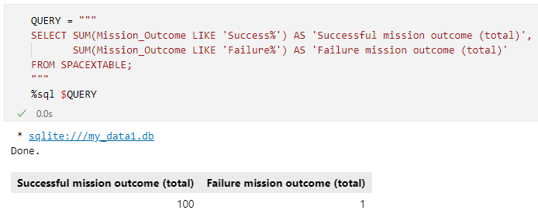
Total Number of Successful and Failure Mission Outcomes
This SQL query calculates the total number of successful and failed mission outcomes from the SPACEXTABLE. It uses the LIKE operator to count rows where Mission_Outcome starts with 'Success' or 'Failure', returning the sums as 'Successful mission outcome (total)' and 'Failure mission outcome (total)'

Slide 31
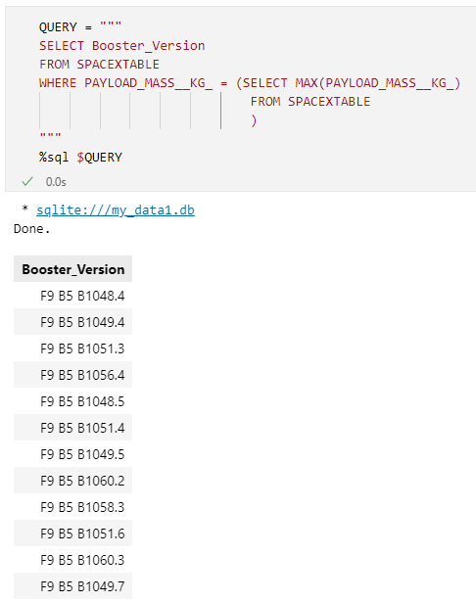
Boosters Carried Maximum Payload
This SQL query retrieves the Booster_Version from the SPACEXTABLE for the rockets with the maximum payload mass. The subquery selects the maximum value of PAYLOAD_MASS__KG_ from the table, and the outer query matches this value to return the corresponding Booster_Version.

Slide 32
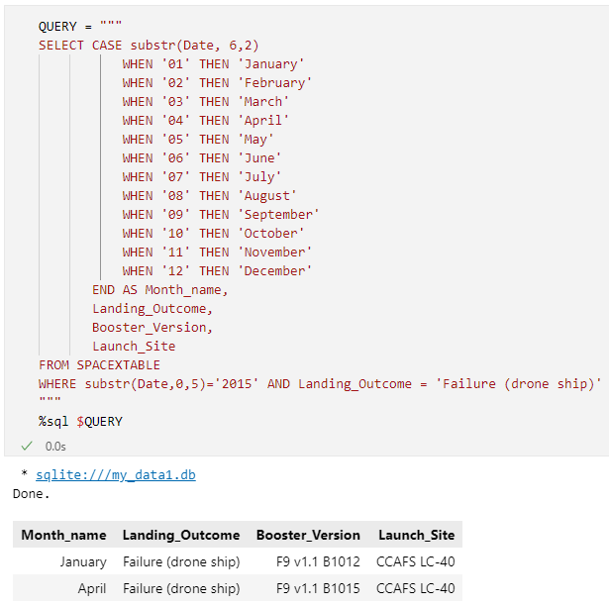
2015 Launch Records
This SQL query extracts data from the SPACEXTABLE for the year 2015, specifically focusing on failed landing outcomes on a drone ship. It includes columns for the month name (derived from the Date column), Landing_Outcome, Booster_Version, and Launch_Site. The query uses the CASE statement to convert the month number into a month name and filters the results to only include records where the year is 2015 and the Landing_Outcome is 'Failure (drone ship)'.

Slide 33
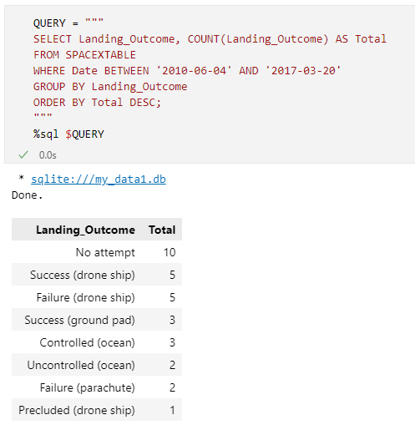
Rank Landing Outcomes Between 2010-06-04 and 2017-03-20
This SQL query retrieves and counts the occurrences of different landing outcomes from the SPACEXTABLE within a specified date range (from June 4, 2010, to March 20, 2017). The results are grouped by Landing_Outcome and ordered in descending order of the total count for each landing outcome. The output includes the landing outcomes and their respective counts.

Slide 34

Section 3

Slide 35
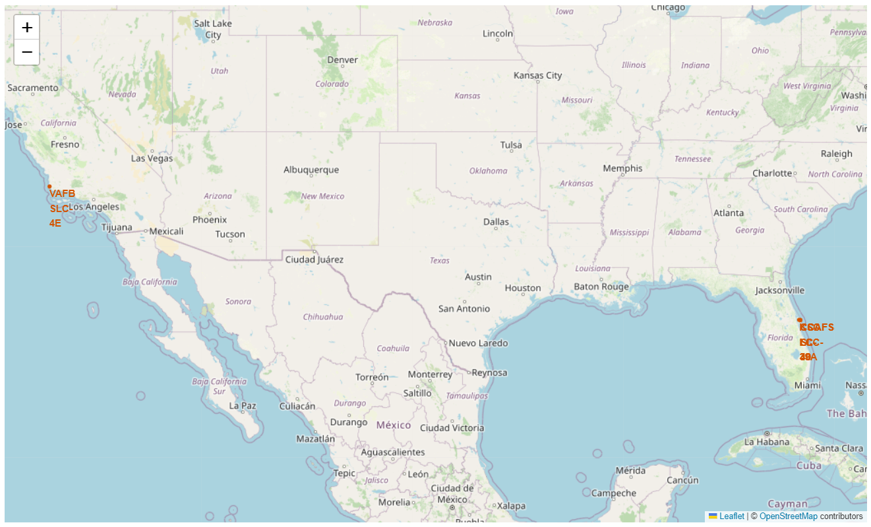
Locations of SpaceX Falcon 9 Launch Sites
The location of SpaceX's launch sites is determined by several key factors, including geographical, technical, and economic considerations.
Launch sites closer to the equator, such as those at Cape Canaveral (CCAFS and KSC), allow rockets to take advantage of the Earth's higher rotational speed. This makes eastward launches more fuel-efficient.

Slide 36
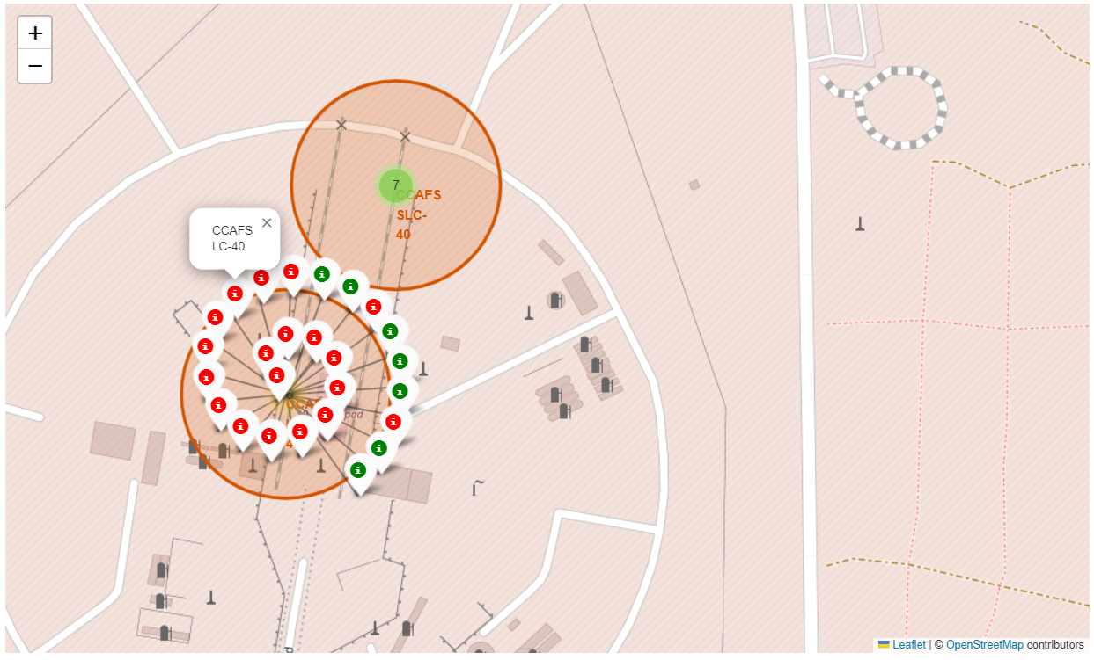
First Stage Landing Outcomes: Success and Failure
Markers indicating the outcomes of first stage landings have been added to the map: green markers represent successful landings, and red markers represent failures.

Slide 37
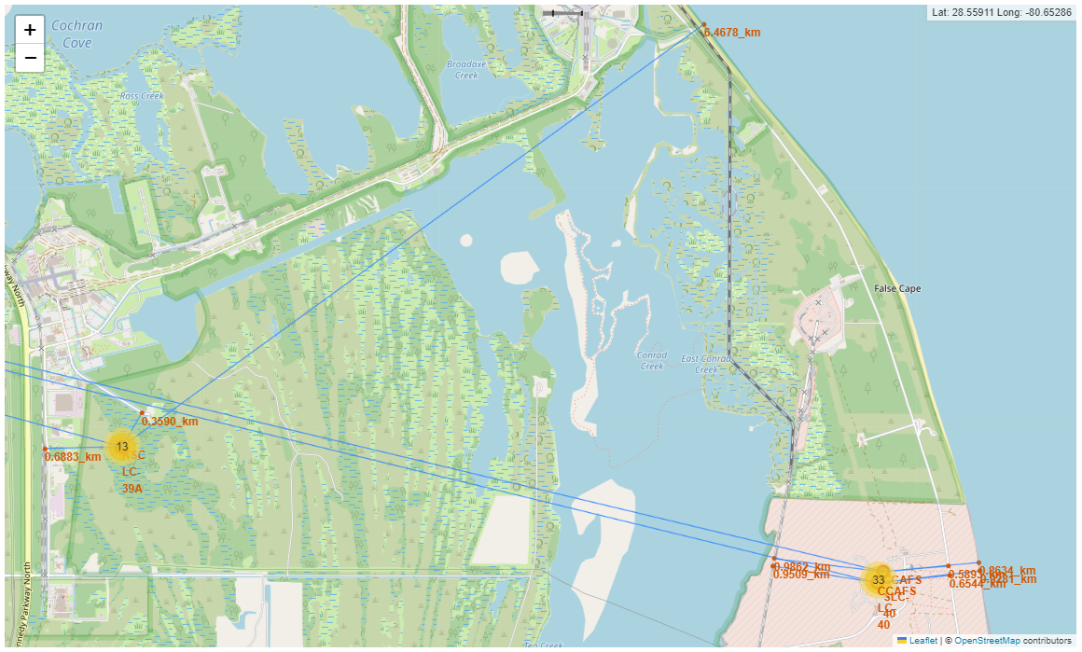
Proximity of SpaceX Launch Sites to Key Infrastructure
Rocket launch sites for SpaceX must meet specific criteria for communication, such as proximity to railways, highways, and the coastline. These factors are crucial for the functionality of the launch complex. According to the data, the proximity to these elements is generally around 1 kilometer or less, except for the distance from KSC LC-39A to the coastline, which is 6.5 kilometers. Additionally, the distance from each launch site to the nearest city is at least 13 kilometers.

Slide 38

Section 4

Slide 39
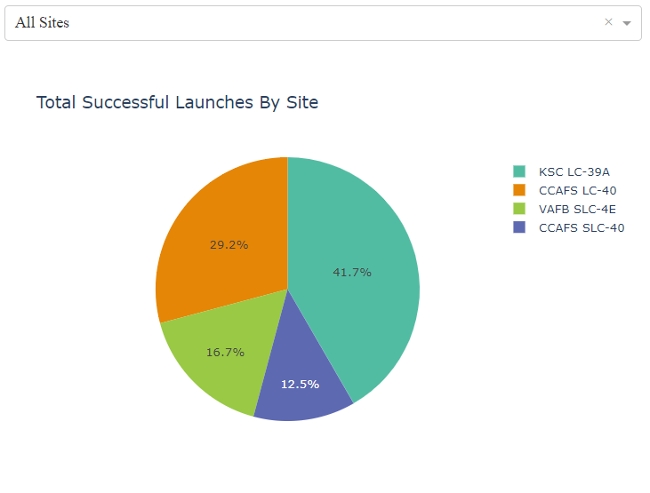
Launch Success Count Across All Sites
Shown on the pie chart is the distribution of successful first stage landings across different launch sites. The highest percentage of successful landings belongs to KSC LC-39A at 41.7%. The lowest percentage is at CCAFS SLC-40, with 12.5%.

Slide 40
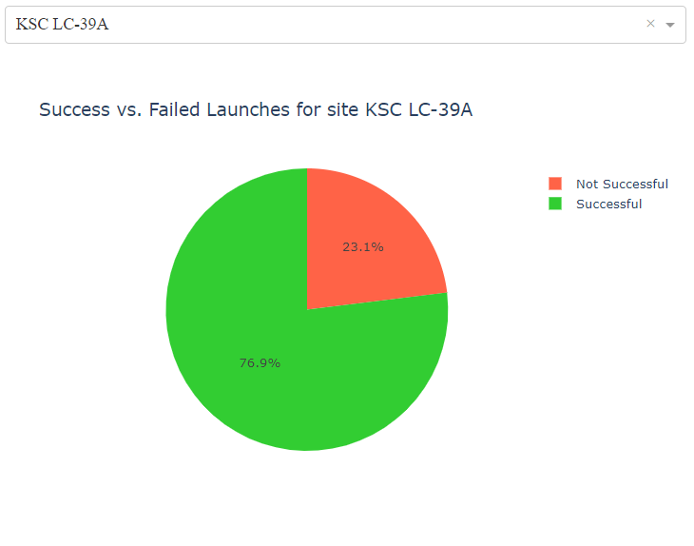
Success Rates of First Stage Landings by Launch Site
The pie chart displays the ratio of successful and unsuccessful first stage landings for each launch site. It shows the example with the highest success rate 76.9% for KSC LC-39A.

Slide 41
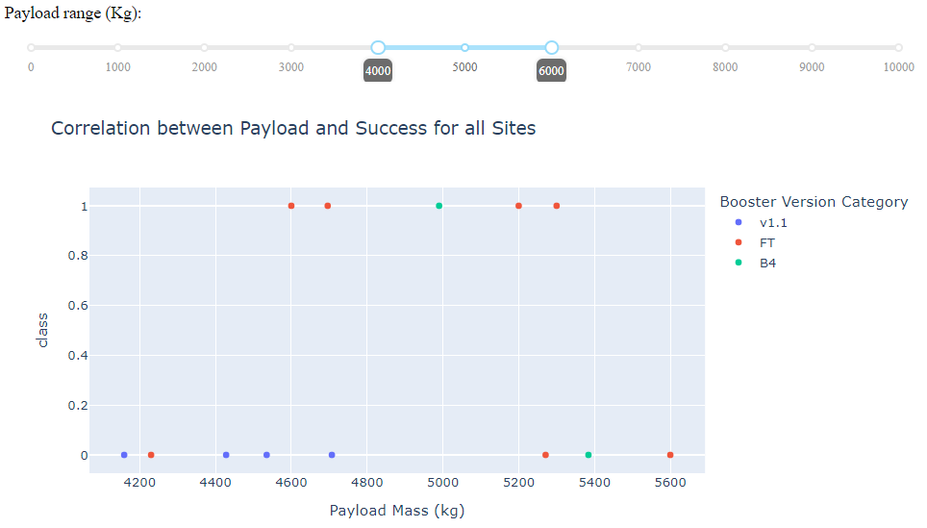
Payload vs. Launch Outcome scatter plot
Booster Version | Successful landing | Not successful landing | Percent of successful landings
v1.0 | 0 | 5 | 0%
V1.1 | 1 | 14 | 6.67%
FT | 16 | 8 | 66.67%
B4 | 6 | 5 | 54.55%
B5 | 1 | 0 | 100%
Presented is a scatter plot for all launch sites, focusing on payloads ranging between 4000 and 6000 kg. The FT, B4, and B5 engines demonstrate the best performance. Launches with payloads heavier than 5.5 tons tend to have a lower first stage landing success rate.

Slide 42

Section 5

Slide 43
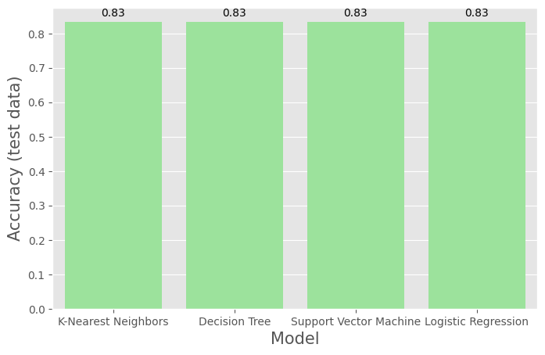
Classification Accuracy
Decision Tree Model Summary
Best Parameters:
Criterion: Gini
Max Depth: 8
Max Features: Square root of total features
Min Samples Leaf: 2
Min Samples Split: 10
Random State: 2
Splitter: Best
Best Model:
DecisionTreeClassifier(max_depth=8, max_features='sqrt', min_samples_leaf=2, min_samples_split=10, random_state=2)
Cross-Validation Accuracy: 87.68%
Test Data Accuracy: 83.33%
All machine learning models performed equally well on the test data, with accuracies exceeding 83.33%. Decision Tree model is preferred due to its high interpretability, effectiveness in handling outliers, and achieving the highest cross validation accuracy among the considered models.

Slide 44

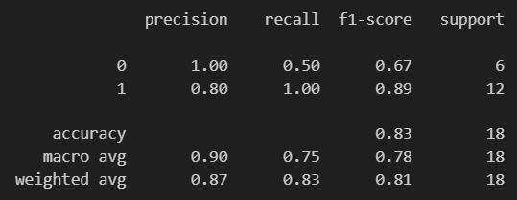
Confusion Matrix
True Positives (TP = 12): Correctly predicted 12 positive instances.
True Negatives (TN = 3): Correctly predicted 3 negative instances.
False Negatives (FN = 0): No positive instances were misclassified as negative.
False Positives (FP = 3): 3 negative instances were misclassified as positive.
Key Performance Metrics
Accuracy: 83.3%
Precision: 80%
Recall (Sensitivity): 100%
Specificity: 50%
F1 Score: 88.9%
Summary
The model demonstrates excellent recall and good precision, accurately identifying positive instances while having a moderate rate of false positives. The overall accuracy is 83.3%, indicating a reliable performance in most cases.

Slide 45
Conclusions
Optimal Launch Sites Identified: Cape Canaveral and Vandenberg were confirmed as key SpaceX launch sites due to their geographical and technical advantages, including proximity to the equator and access to necessary infrastructure.
Successful Landing Insights: KSC LC-39A showed the highest percentage of successful first-stage landings at 41.7%, emphasizing the importance of this site for SpaceX operations.
Best Performing Model: Among the machine learning models evaluated, the Decision Tree model emerged as the most effective, achieving the highest cross-validation accuracy and demonstrating strong performance in handling outliers.
Model Performance Metrics: The Decision Tree model achieved an accuracy of 83.3% on test data, with excellent recall (100%) and good precision (80%), indicating its reliability in predicting launch outcomes.
Payload vs. Launch Outcome: Analysis revealed that the FT, B4, and B5 engines perform best for payloads between 4000 and 6000 kg, while heavier payloads (>5.5 tons) tend to have lower first-stage landing success rates. Time, accumulated experience and technology are the best indicator of the success of the first stage landing.
Comprehensive Data Analysis: SQL queries provided valuable insights into payload mass, mission outcomes, and landing success rates, supporting data-driven decision-making for SpaceX operations.

Slide 46
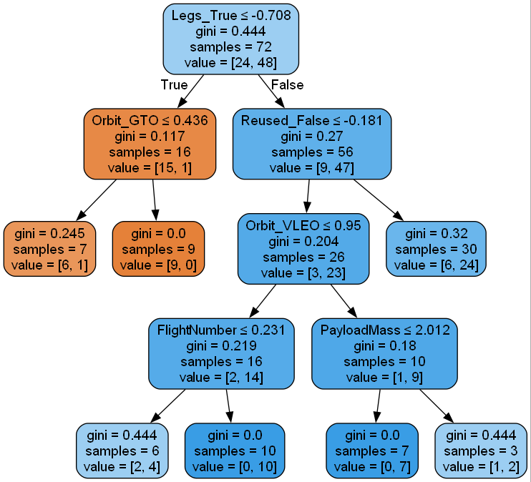
Appendix
Decision Tree Model

Slide 47


